Slide 1



Traffic Violation Detection System
Final year project [csc-500]

Slide 2
INTRODUCTION
Road accidents have been very common in the present world with the prime cause being the careless driving.
The necessity to check this has been very essential and different methods have been used so far.
However, with the advancement in the technology, different governing bodies are demanding some sort of computerized technology to control this problem of over speed driving.

Slide 3
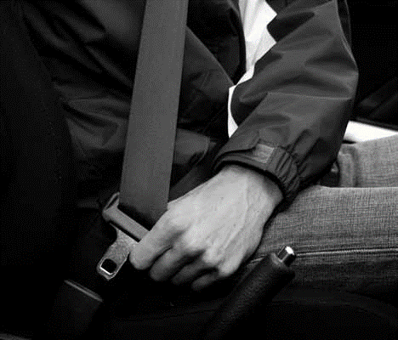
INTRODUCTION
We are proposing a system to detect traffic violations such as:
Not wearing seat belts

Slide 4
PROBLEM STATEMENT
develop a real-time traffic violation detection system that will work efficiently under the supervision of human
Detect the objects that are merged into the background due to a temporary stop
Adapting different traffic environment conditions, robustness against progressive or sudden illumination changes.

Slide 5
OBJECTIVES
This work is aimed at developing an android application that depicts smart traffic offence analysis tool.
To develop an application that is faster, efficient and manageable.
To prepare complete, integrated solution for traffic offence management.

Slide 6
POPULATION, ROAD TRAFFIC DEATHS AND REGISTERED VEHICLES
Ninety-percent of road traffic deaths occur in low- and middle-income countries.
These countries account for 82% of the world’s
Population
A disproportionate number of deaths relative to their level of motorization (see next slide)

Slide 7
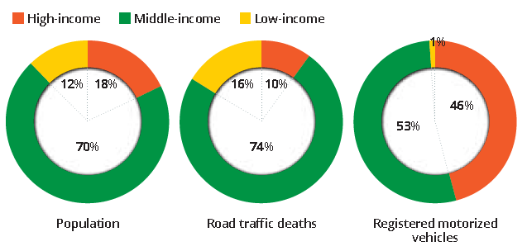
Population - Death – registered in countries with income status

Slide 8
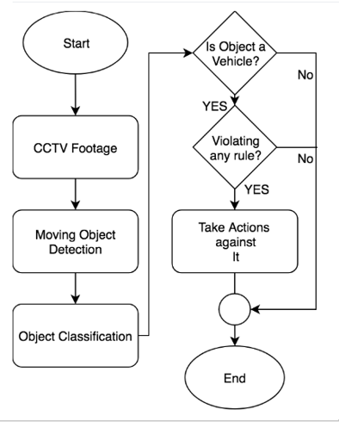
SYSTEM OVERVIEW

Slide 9
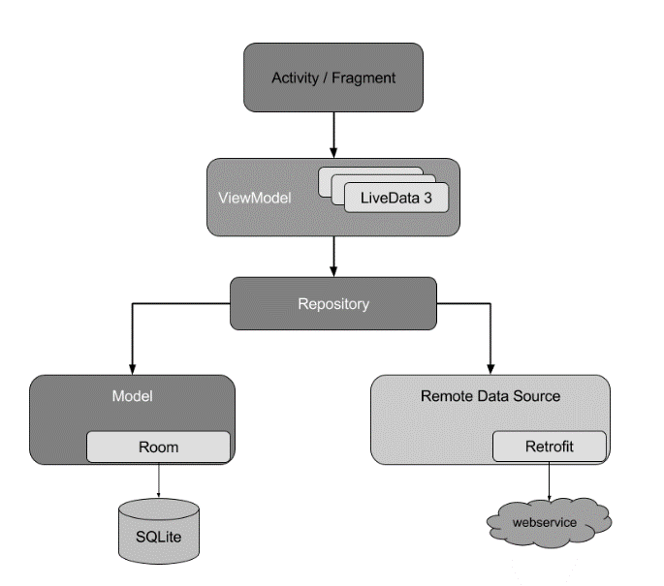
APP OVERVIEW

Slide 10
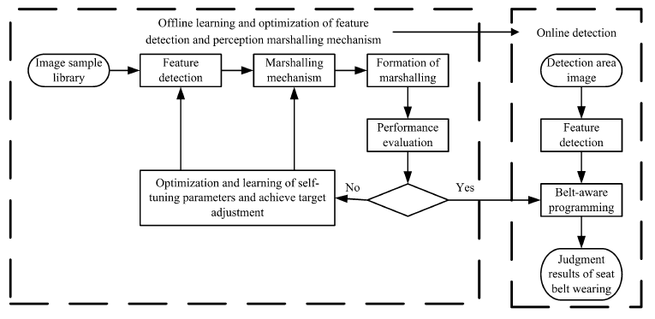
DETECTION MODEL

Slide 11
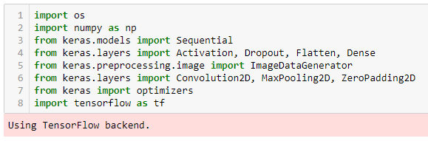
Libraries Used

Slide 12
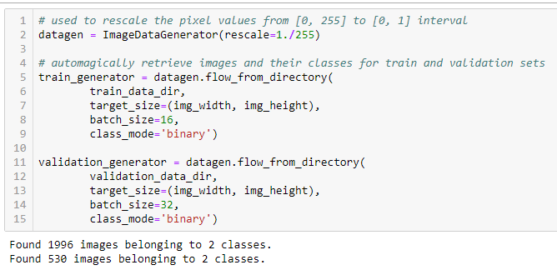
Training Tensors

Slide 13
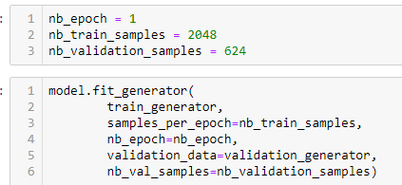
Generating model

Slide 14
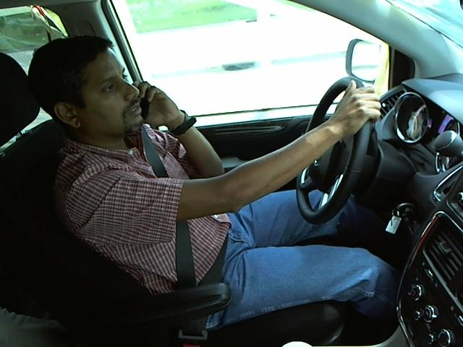
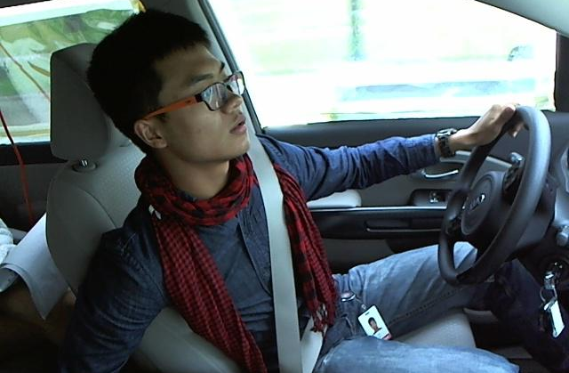
Training data (Seatbelt)

Slide 15
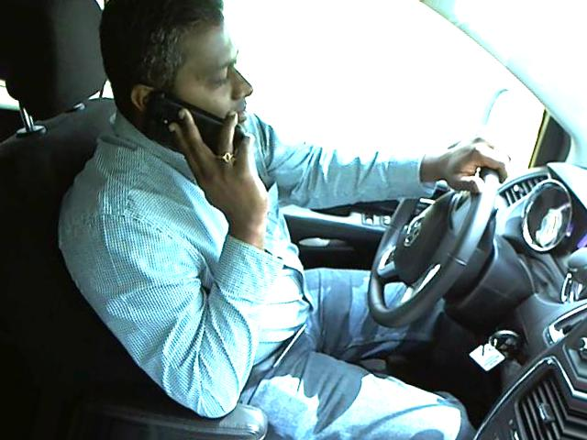
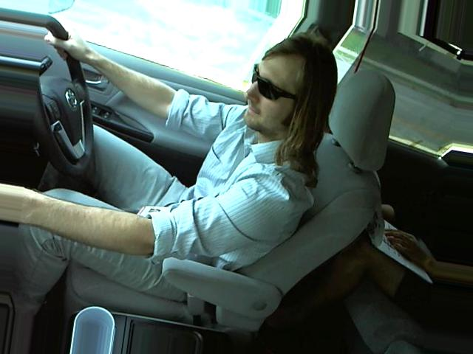
Training data (No Seatbelt)

Slide 16
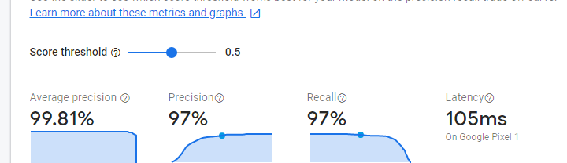
Model Evaluation

Slide 17
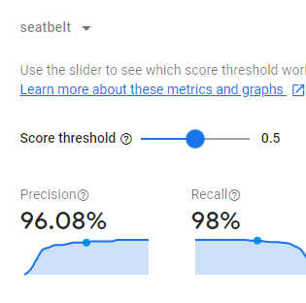
Evaluation for seatbelt

Slide 18
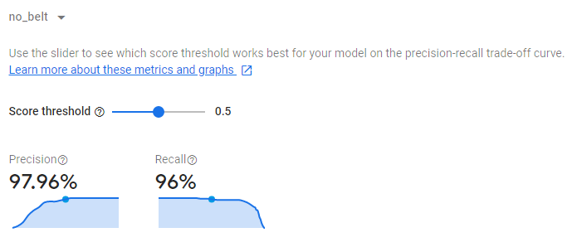
Evaluation for no seatbelt

Slide 19
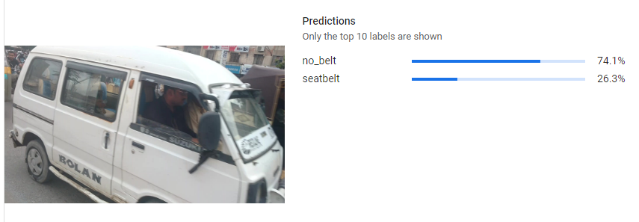
Model Evaluation (No seatbelt)

Slide 20
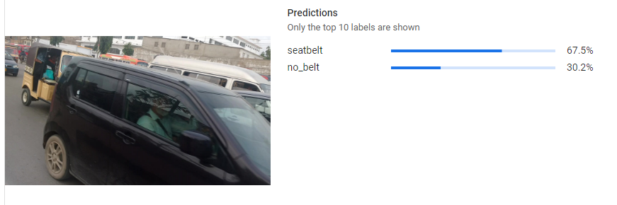
Model Evaluation (seatbelt)

Slide 21
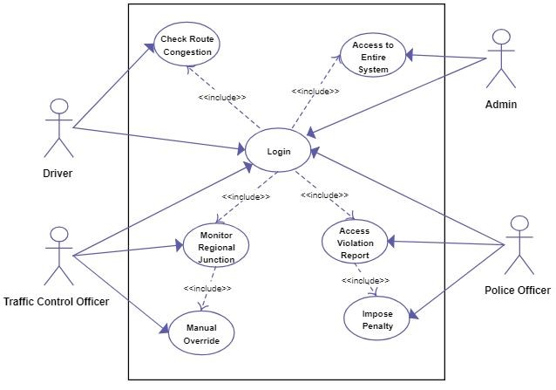
USE CASES

Slide 22
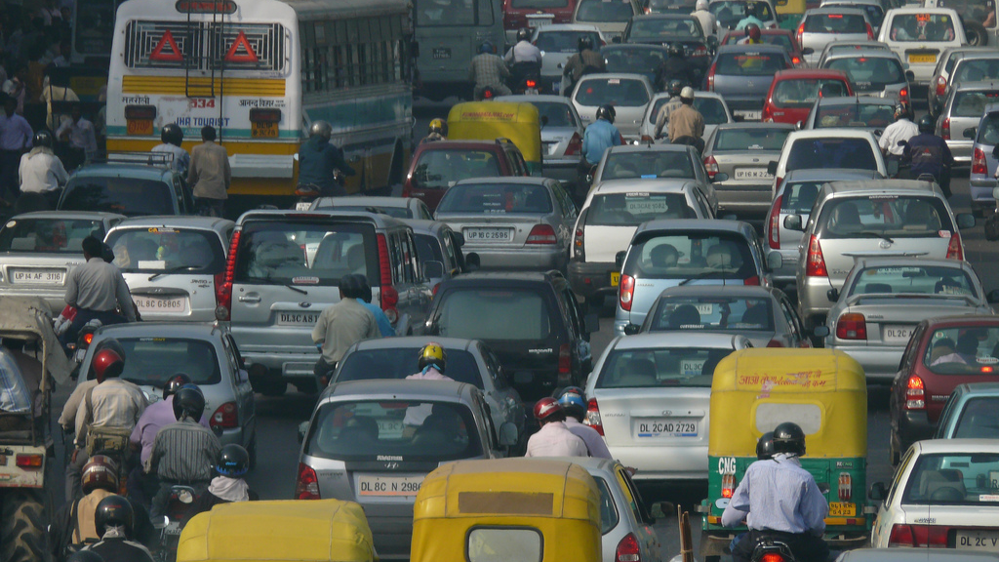
THANK YOU
This Photo by Unknown Author is licensed under CC BY-SA

